Slide 1


Course Outline

Slide 2
Rough schedule
Monday
Types
Multiple Dispatch
Tuesday
Linear algebra
Machine learning
Wednesday
Parallelism
Thursday
Friday
- Holiday -
Hackathon
Gotchas
Environments
Profiling
Debugging
Ecosystem
Generic programming
Workflow
Revise
Git + GitHub
MyPackage 1.0
Julia Community

Slide 3
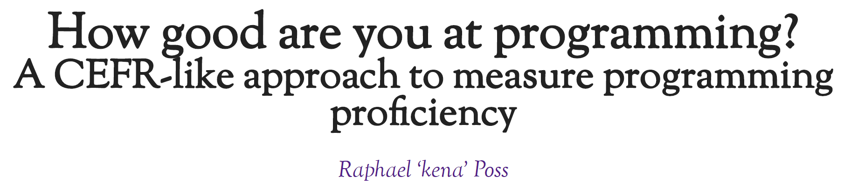
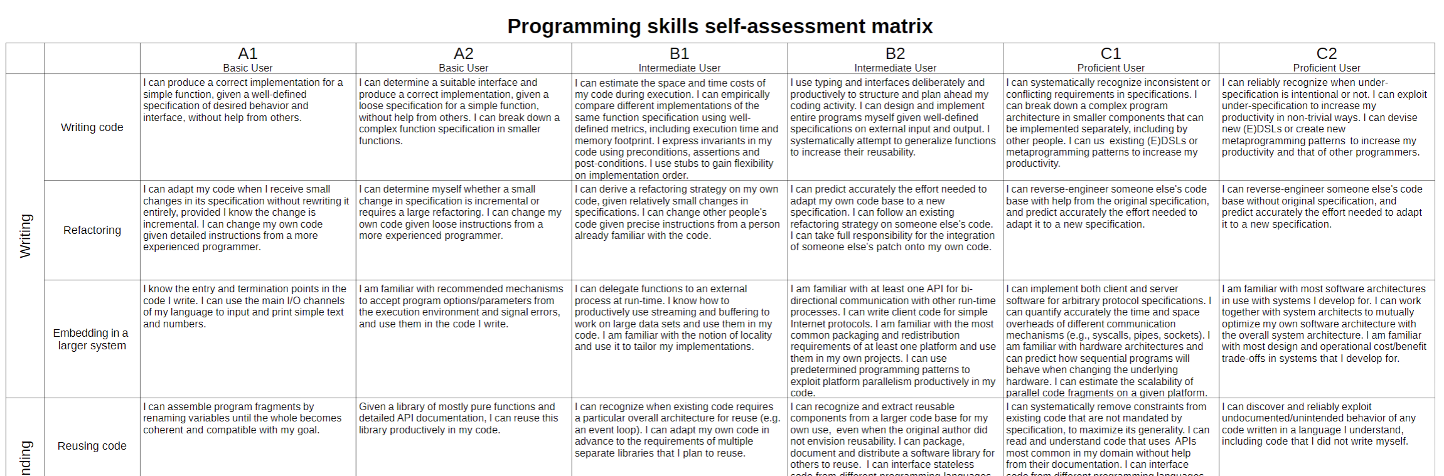
https://science.raphael.poss.name/programming-levels.html
Notes:
Common European Framework of Reference for Languages – language proficiency

Slide 4
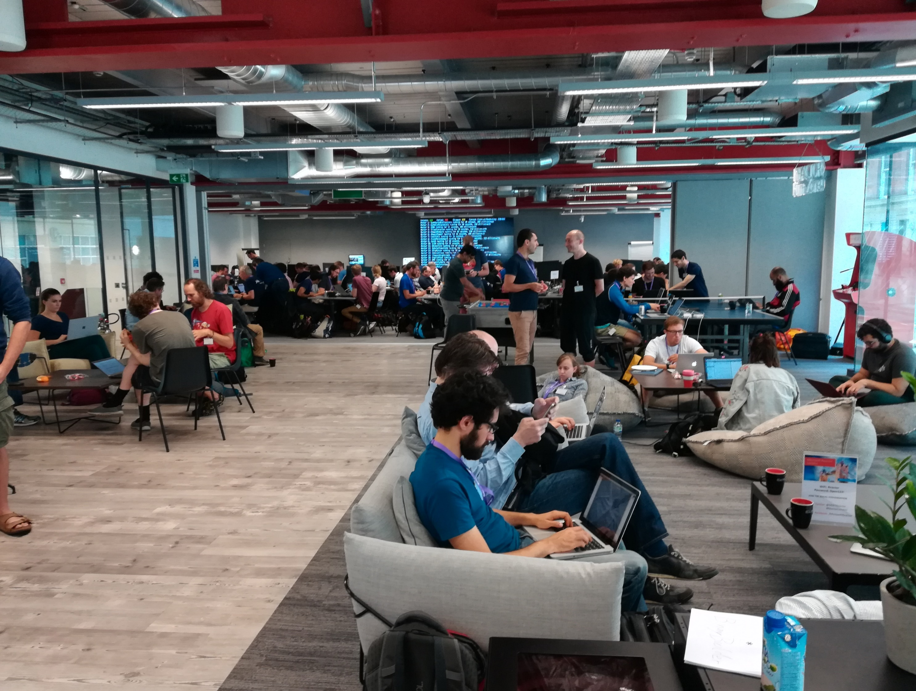




2018

Slide 5
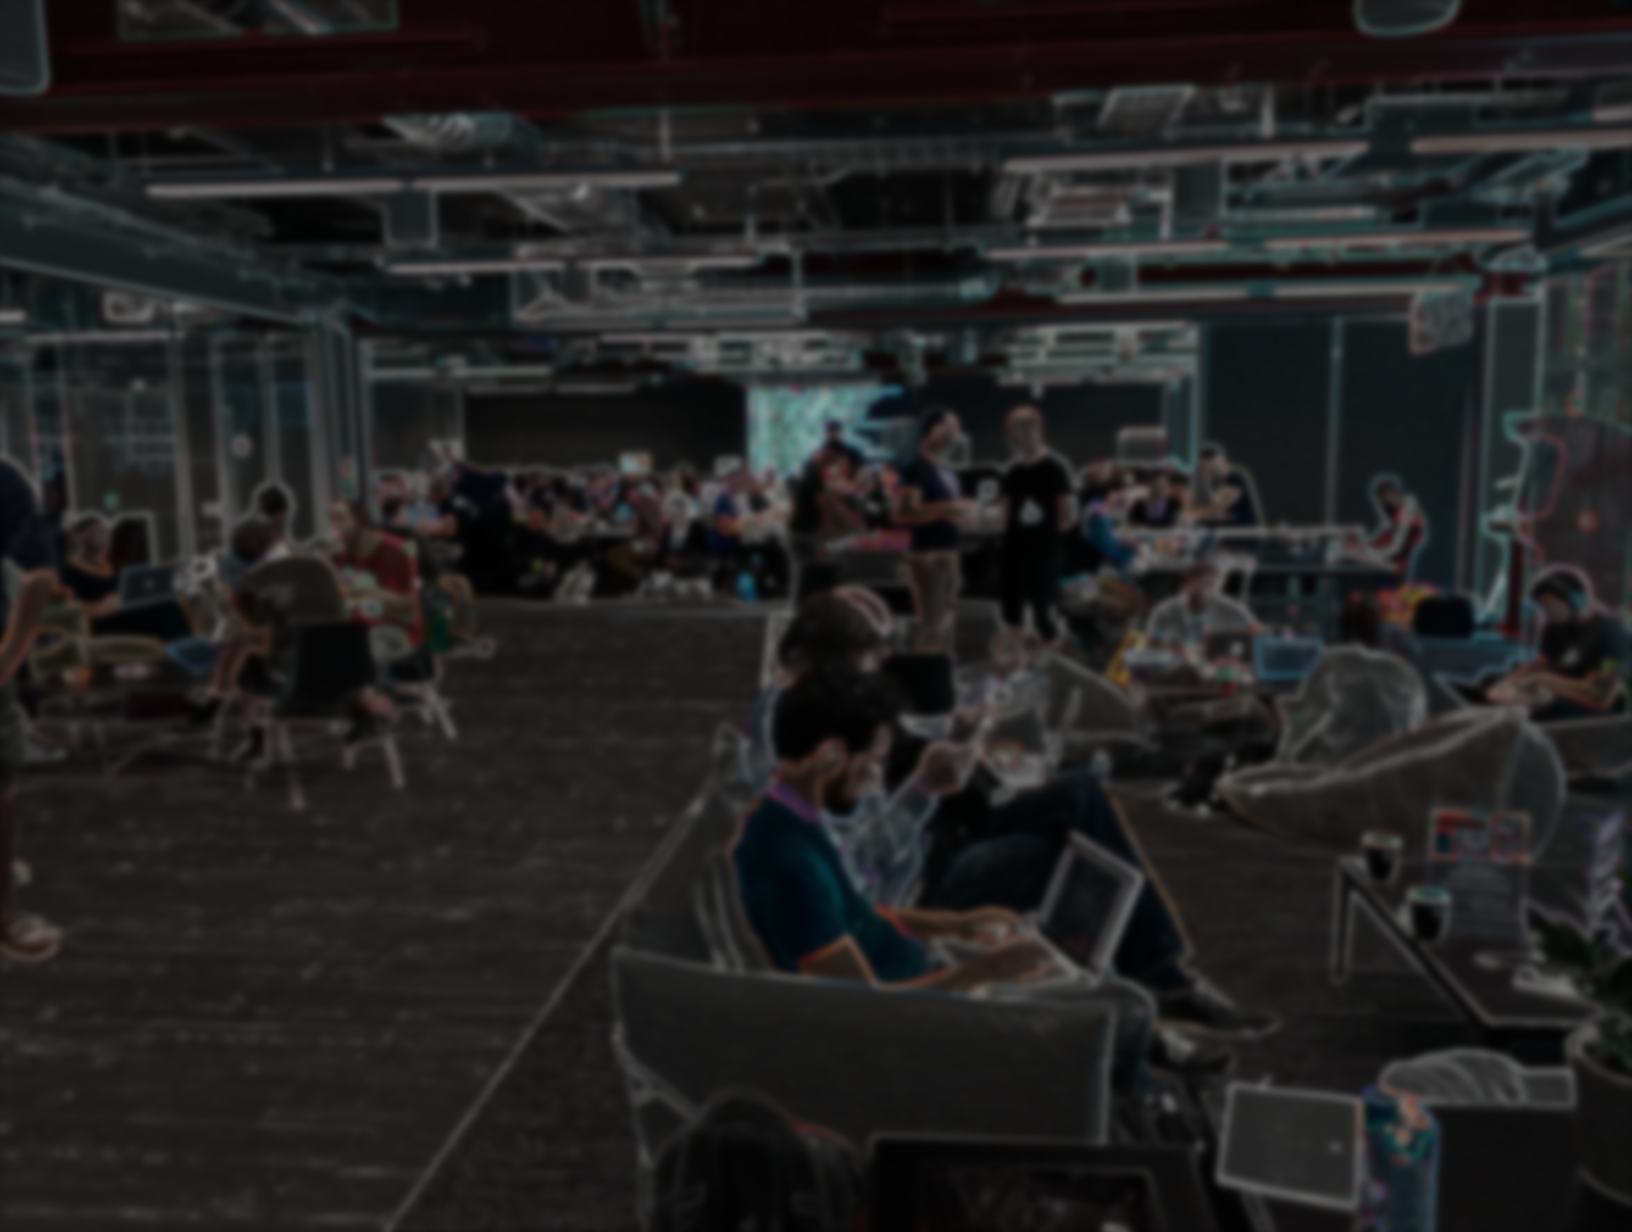

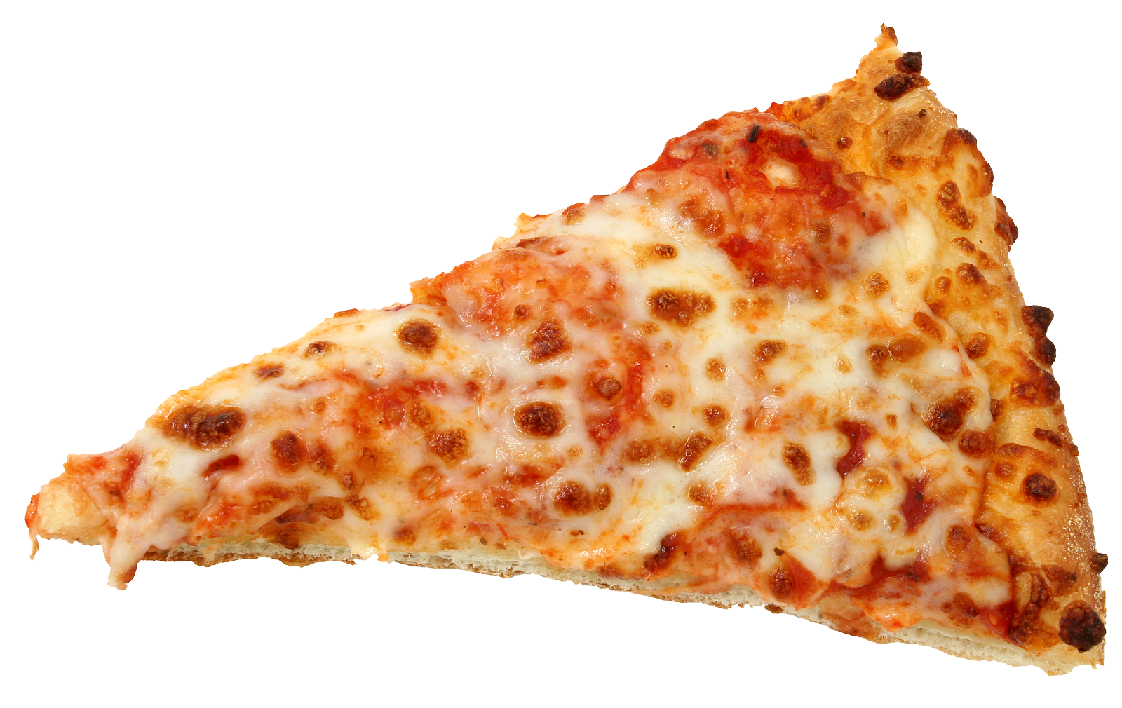
Hackathon
Choose a problem
Connect with others
Solve together!
Eat free pizza ☺

Slide 6
Hackathon
Choose a problem
Connect with others
Solve together!
Eat free pizza ☺

Slide 7


Hackathon
Choose a problem
Connect with others
Solve together!
Coding together is fun!

Slide 8

Disclaimer
This workshop will be opinionated!
This workshop will be incomplete!
The topics will (likely) be too easy and too difficult!
There are other great languages out there!

